Slide 1
Principle of Pharmacy
مبادئ الصيدلة
Dr. Mohammed Sabbar
College Of Pharmacy - Basrah
Nov. 2018
http://bit.ly/2DKNTSX

Slide 2
Calculating Weight, Knowing the Volume and Specific Gravity
Weight (g)= volume (mL) X Sp gr
What is the weight, in grams, of 3620 mL of alcohol with a specific gravity of 0.820?
3620 mL of water weigh 3620 g
3620g x 0.820=2968g, answer.

Slide 3
What is the weight, in grams, of 2 fl. oz. of a liquid having a specific gravity of 1.118?
2x29.57mL=59.14mL
59.14mL of water weigh 59.14g
59.14g x 1.118 = 66.12g, answer.

Slide 4
Calculating Volume, Knowing the Weight and Specific Gravity
$$Volum (mL)=\frac{weight }{sp gr}$$
What is the volume, in milliliters, of 492 g of nitric acid with a specific gravity of 1.40?
492 g of water measure 492 mL
$volume=\frac{492}{1.4}$ = 351mL

Slide 5
What is the cost of 1000 mL of glycerin, specific gravity 1.25, bought at $54.25 per pound?
Weight of 1000mL of glycerin = 1000g x 1.25 = 1250g
$\frac{454 g}{1250 g}$ = $\frac{\left(\$\right)25.25}{\left(\$\right) x}$
$$x=\left(\$\right)149.37 Answer$$

Slide 6
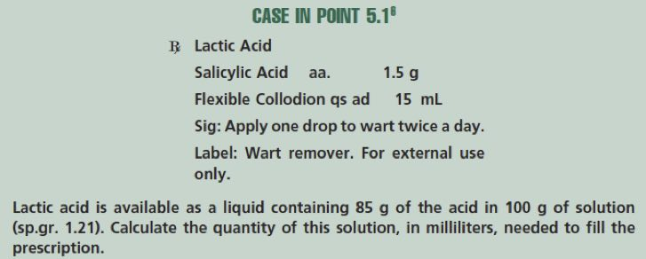
? mL of Lactic acid
1.5 g required
? mL of Lactic acid required
100g /1.21=82.64mL in its solution
x mL=(85/82.64 ) / 1.5g= 1.46mL

Slide 8
Specific volume
Abstract number representing
The ratio, expressed decimally, of the volume of a substance to the volume of an equal weight of
Another substance taken as a standard, both having the same temperature
Notes:
Specific volume, in pharmaceutical practice, is usually defined as an abstract number representing
the ratio, expressed decimally, of the volume of a substance to the volume of an equal weight of
another substance taken as a standard, both having the same temperature

Slide 9
Example:
Calculate the specific volume of a syrup, 91.0 mL of which weighs 107.16 g.
107.16 g of water measures 107.16 mL

Slide 10
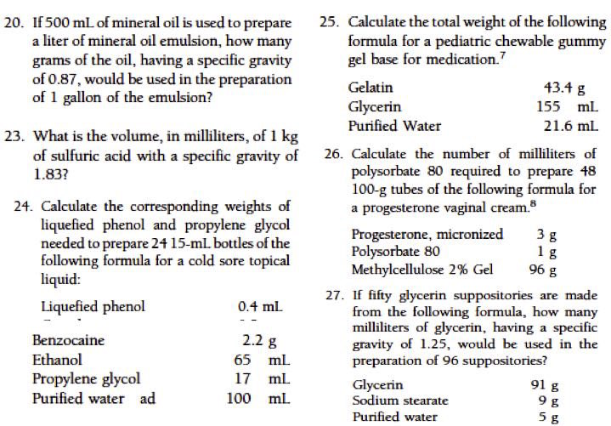

Slide 11
percent vs percentage
Percentage and ratio strength calculation. Ch-6
% sign vs value
Percent weight-in-volume (w/v) expresses g/100 mL of solution or liquid prep. Expressed as: % w/v.
Percent volume-in-volume (v/v) expresses x mL/100mL of solution or liquid prep.)and Expressed as: % v/v.
Percent weight-in-weight (w/w) expresses g/100 g of solution or liquid prep. Expressed as: % w/w.

Slide 12
Supp.
Volume (mL, representing grams) X % (expressed as a decimal) = grams (g) of solute or constituent

Slide 13
How many grams of dextrose are required to prepare 4000 mL of a 5% solution? 4000 mL represents 4000 g of solution 5% = 0.05 4000 g X 0.05= 200 g, answer. Or, solving by dimensional analysis:
Weight-in-Volume Calculations

Slide 14
How many grams of aminobenzoic acid should be used in preparing 8 fluidounces of a 5% solution in 70% alcohol?
8 fl. oz. = 8 X 29.57 mL =236.56 mL
236.56 mL represents 236.56 g of solution
5% =0.05
236.56 g X 0.05 =11.83 g, answer.

Slide 15
Volume-in-Volume Calculations
How many milliliters of liquefied phenol should be used in compounding the following prescription?
240 mL X 0.025 = 6 mL, answer

Slide 16
In preparing 250 mL of a certain lotion, a pharmacist used 4 mL of liquefied phenol. What was the percentage (v/v) of liquefied phenol in the lotion?
Peppermint spirit contains 10% v/v of peppermint oil. What volume of the spirit will contain 75 mL of peppermint oil?

Slide 17
How many grams of phenol should be used to prepare 240 g of a 5% (w/w) solution in water?
Weight-in-Weight Calculations
Weight of solution (g) X % (expressed as a decimal) = g of solute
240 g X 0.05 = 12 g, answer.

